Slide 1
Uncovering and modeling complex behaviors in Social media
Meng Jiang
Department of Computer Science and Technology, Tsinghua University
Advisor: Professor Shiqiang Yang
Contact: mjiang89@gmail.com
Homepage: www.meng-jiang.com

Slide 2
In This Talk
3 parts of works + 1 interesting discussion
QA after each part
Time limited: Just key ideas (General philosophy)
Intro & QA: Technical details offline, if too much
My Net ID: mjiang89@illinois.edu
My Office: SC 2130
My Interests
Behavior modeling and analysis
Recommendation and fraud detection
Basketball and talk shows (Chinese, sorry)

Slide 3





Background: Behaviors in Social Media
Scientists can study user behaviors now!
We have richer behaviors in social media!
“user-user”
interaction
“user-information”
interaction
social network
social media
user
information
Data

Slide 4



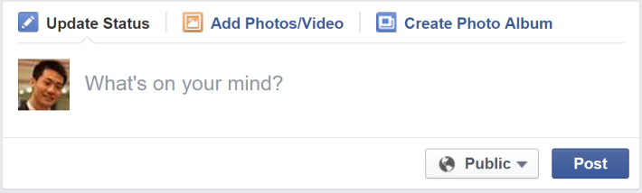
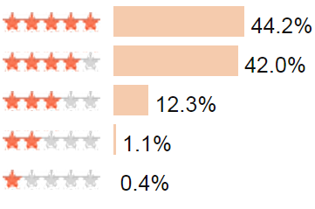

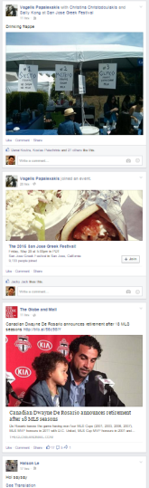

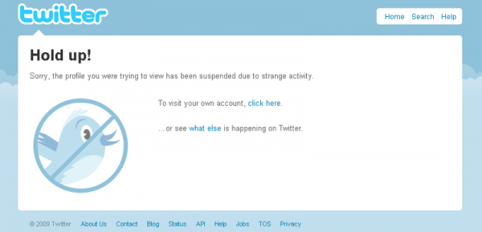
Background: Behavior-Oriented Systems
Great marketing values!
Post, forward text/image
Give ratings to movies
Zombie followers, fraud
News feed ranking
Recommender systems
Anti-spam, anti-fraud

Slide 5
Behavioral Analysis and Modeling
The 1st step to implement a behavioral system
The basis of social media services
The key problem of social data processing
Data
Service/System
Analysis
user
social media
Modeling
Behavior-oriented algorithms
information

Slide 6
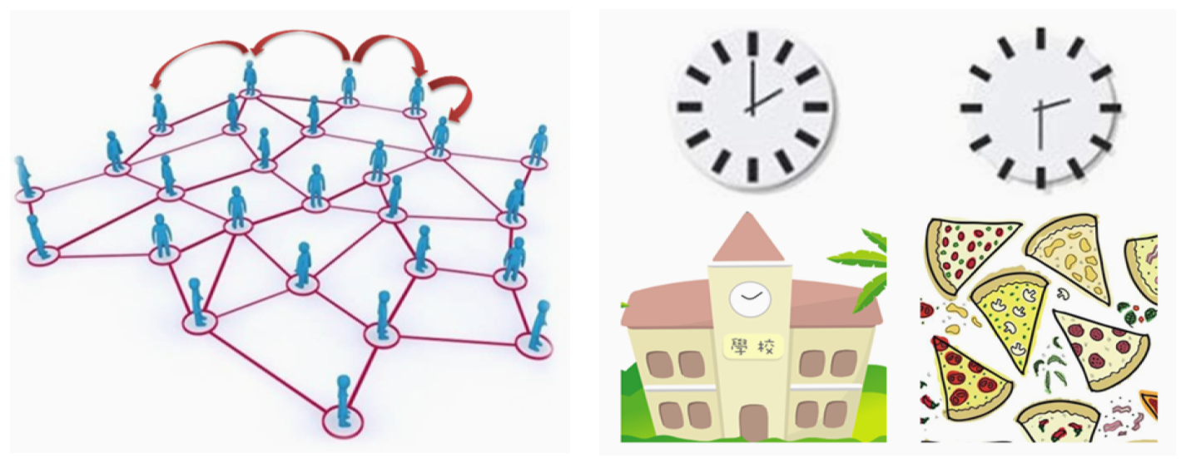
Complex Behaviors in Social Media
Complex behavior
Contextual
Cross-domain
Cross-platform
Suspicious
Spatial-temporal
contexts
Social contexts

Slide 7
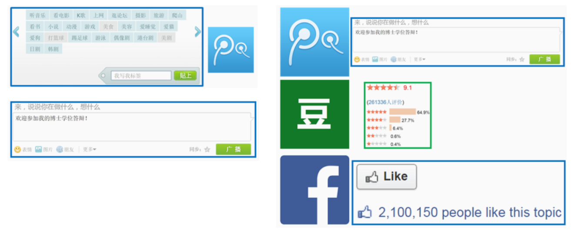
Complex Behaviors in Social Media
Complex behavior
Contextual
Cross-domain
Cross-platform
Suspicious
Cross-domain
Cross-platform

Slide 8
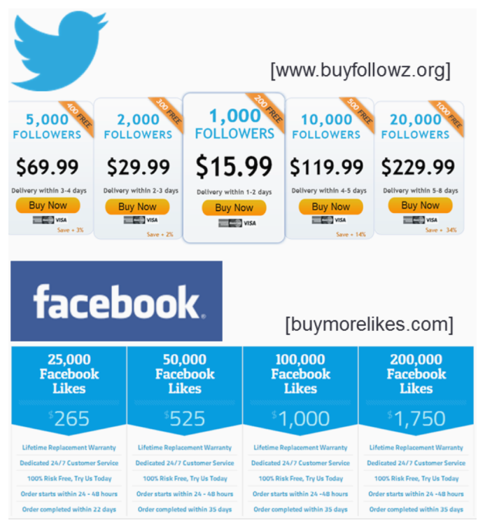
Complex Behaviors in Social Media
Complex behavior
Contextual
Cross-domain
Cross-platform
Suspicious
Suspicious
zombie follower
ill-gotten “Likes”

Slide 9
Complex Behaviors in Social Media
Complex behavior
Contextual
Cross-domain
Cross-platform
Suspicious

Slide 10
Related Works
Information adopting behavior prediction
Content-based filtering [Balabanovic et al. ’97][Basu et al. AAAI’98]
Memory-based Collaborative Filtering [Herlock et al. SIGIR’99][Sarwar et al. WWW’01]
Homophily [McPherson et al. ’01]
Social Influence [Leskovec et al. PAKDD’06]
Model-based CF [Yehuda KDD’08][Ma et al. CIKM’08][Ma et al. WSDM’11]
Suspicious behavior detection
Duplicated content [Jindal et al. WSDM’08]
Spam text and image [Lim et al. CIKM’10]
Burst [Xie et al. KDD’12]
Sentiment difference [Hu et al. ICDM’14]

Slide 11
ROadmap
Contextual behavior analysis & modeling
Social context-based behavioral model
Spatial and temporal context-based analysis
Cross-domain/platform behavior modeling
Cross-domain hybrid random walk algorithm
Cross-platform semi-supervised transfer learning
Suspicious behavior analysis & detection
Detecting synchronized suspicious users
Evaluating suspicious multi-faceted behaviors

Slide 12
ROadmap
Contextual behavior analysis & modeling
Social context-based behavioral model
Spatial and temporal context-based analysis
Cross-domain/platform behavior modeling
Cross-domain hybrid random walk algorithm
Cross-platform semi-supervised transfer learning
Suspicious behavior analysis & detection
Detecting synchronized suspicious users
Evaluating suspicious multi-faceted behaviors

Slide 13
P1 & C: Contextual Behavior Modeling
(1) Social relation
Bob
Amy
Tom
(2) “User-user” interaction frequency
Nick
(3) “User-post” interaction
Sparse!
(4) Post content
Post 1
Post 3
Post 2
Existing behavior models
 | (1) Social relation | (2) User-user | (3) User-post | (4) Post content
Content filtering & CF | × | × | √ | √
Social trust & Influence | × | √ | √ | ×
Low-rank matrix factorization | √ | × | √ | √

Slide 14


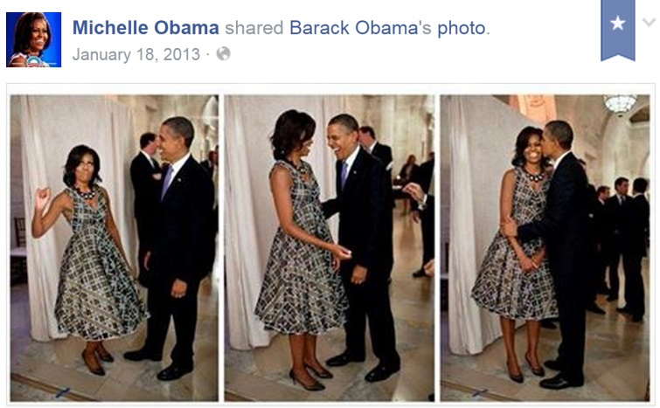
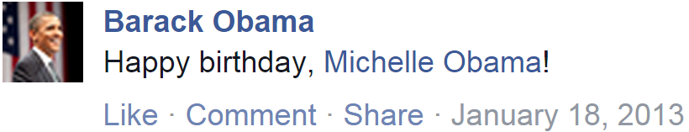
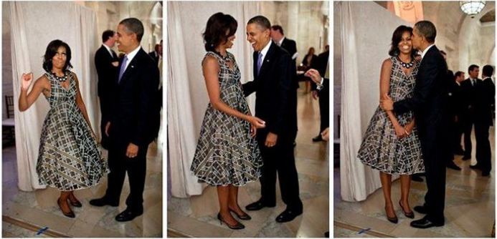
Idea: Social Contextual Factors
Personal preference: Like the content?
Interpersonal Influence: Who is the sender?
(0) follow
(1) post
(2) receive & read
(3) adopt?

Slide 15
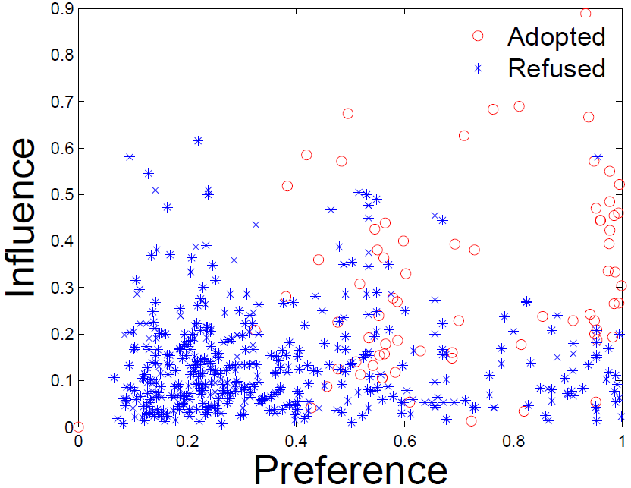
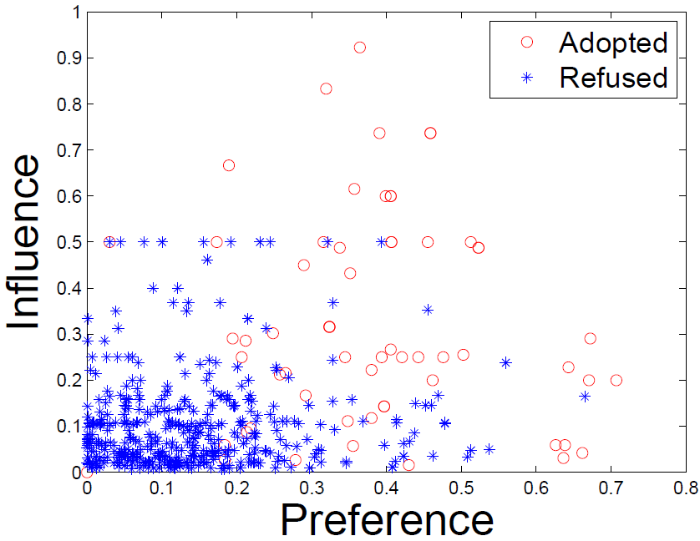
Idea: Social Contextual Factors
China’s Facebook:
Renren
China’s Twitter:
Tencent Weibo

Slide 16
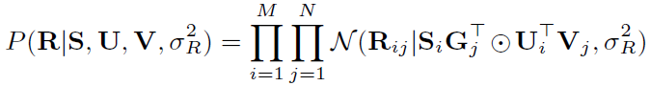
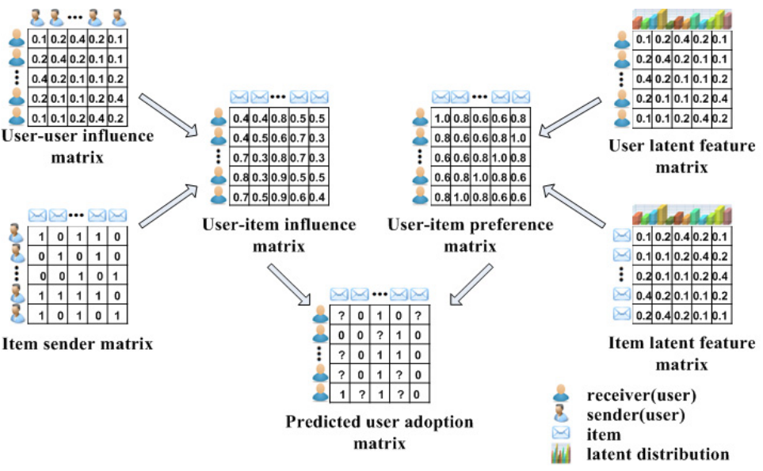
ContextMF: Social Contextual Model
User-sender influence S
User latent features U
Sender G
Item latent features V
Observed behaviors R

Slide 17
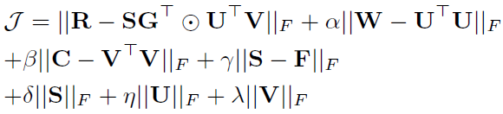
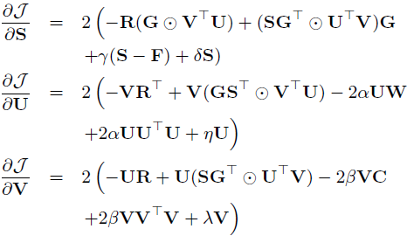
ContextMF Algorithm
Minimize sum-of-squared errors function
Block coordinate descent scheme with gradients

Slide 18
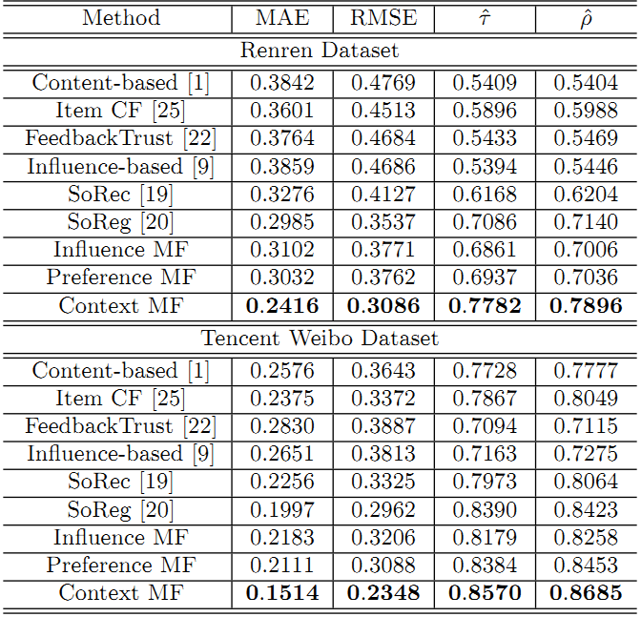
Performance: Predicting Adoptions
 | Renren | Tencent Weibo
MAE | -19.1% | -24.2%
RMSE | -12.8% | -20.7%
Kendall’s | +9.82% | +2.1%
Spearman’s | +10.6% | +3.1%

Slide 19
Contributions
Analyzed social contextual behaviors
Proposed social context-based behavior prediction model ContextMF
Improved behavior prediction performance in real social media
Publications
ACM CIKM 2012 (Full. Acc. rate=13.8%.)
IEEE TKDE 2014 (Regular.)
Citation count: 85

Slide 20


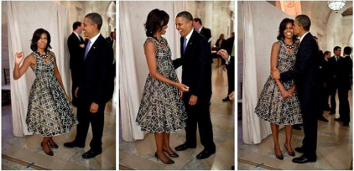

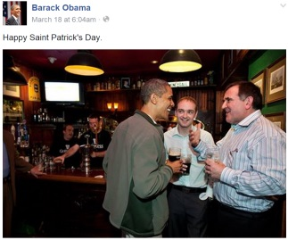
Spatial Temporal Contexts: Multi-faceted and Dynamic Behaviors
Place
Device
Photo
With whom?
Who post?
Text
post
post
time
Jan. 18
Birthday party
@ White house
March 17
St. Patrick’s Day
@ Bar

Slide 21
P2: Spatial temporal context-based behavior modeling
time
Tasks
Who post
User behaviors
Text
Place
Behavior modeling
Tensor sequence
Space:
Multi-faceted
Time:
Dynamic
Pattern discovery
Decomposition & Completion
Behavior prediction
≈
x
x

Slide 22
C & Idea
Challenges
High sparsity
High complexity
Ideas
Flexible regularization with auxiliary data
Incremental updates for projection matrix
user
item
…
user
item
time
t₃
t₂
item
item
time
t₁
user
user
t₁
t₂
t₃

Slide 23
FEMA: Flexible Evolutionary Multi-faceted Analysis with Tensor Perturbation Theory
0~t
Δt
0~(t+Δt)
X
+
ΔX
item
item
user
√
user
×
matricize
update
item
cluster
λ
core tensor
X⁽¹⁾
user
cluster
user
decompose
user
cluster
X⁽²⁾
A⁽¹⁾
item
user
projection
matrix
item
cluster
L⁽¹⁾
L⁽²⁾
user
item
A⁽²⁾
regularize
item
user
item

Slide 24
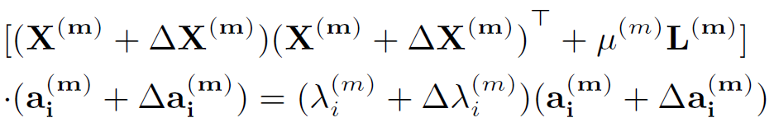
FEMA: Flexible Evolutionary Multi-faceted Analysis with Tensor Perturbation Theory
0~t
Δt
0~(t+Δt)
X
+
ΔX
item
item
user
√
user
×
matricizing
update
item
cluster
λ
core tensor
user
cluster
Tensor Perturbation Theory
X⁽¹⁾
user
decompose
user
cluster
X⁽²⁾
A⁽¹⁾
item
user
projection matrix
item
cluster
L⁽¹⁾
L⁽²⁾
user
item
A⁽²⁾
regularize
item
user
item

Slide 25
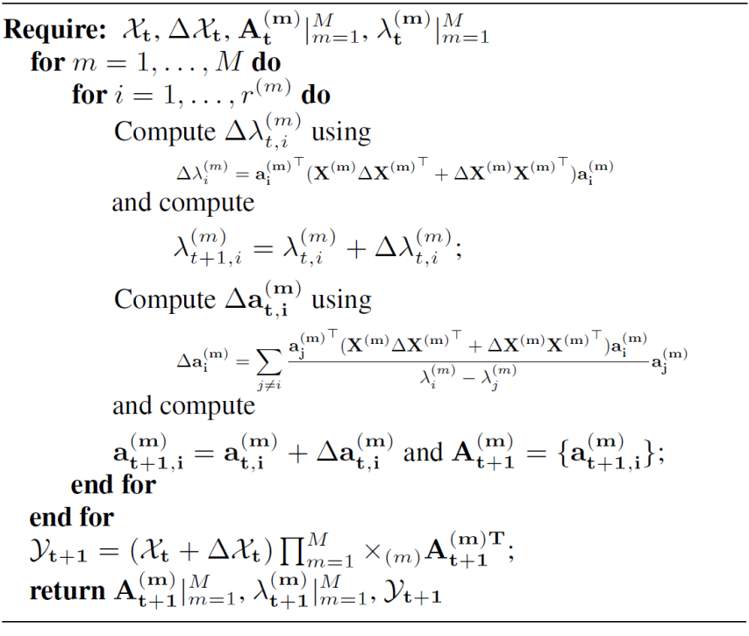
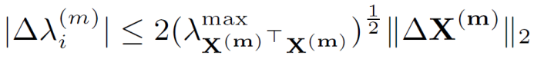
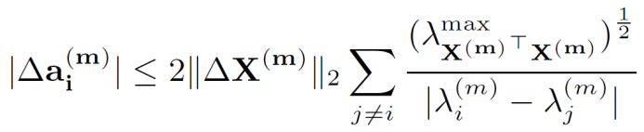
FEMA Algorithm
Approximation
Bound Guarantee
core tensor
projection matrix

Slide 26
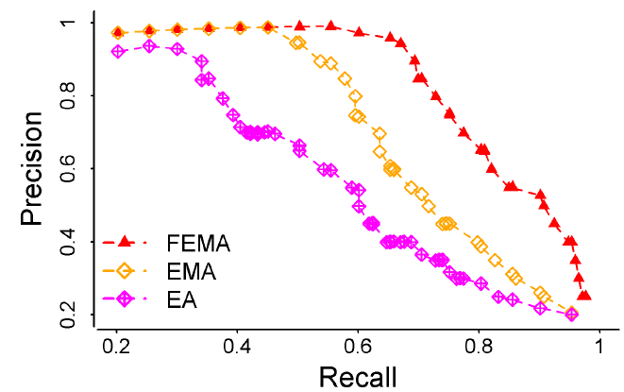
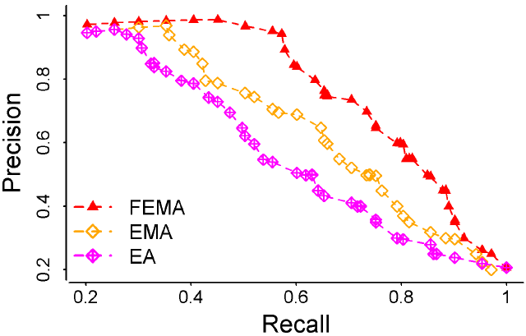
Performance: Predicting academic behaviors and mentioning behaviors
Paper: author-(affiliation)-keyword
Tweet: who @-@ whom-(word)
 | Microsoft Academic Search |  | Tencent Weibo mentions “@”
 | MAE | RMSE | MAE | RMSE
FEMA | 0.735 | 0.944 | 0.894 | 1.312
EMA | 0.794 | 1.130 | 0.932 | 1.556
EA | 0.979 | 1.364 | 1.120 | 1.873
Precision vs Recall
X
L
X
X

Slide 27
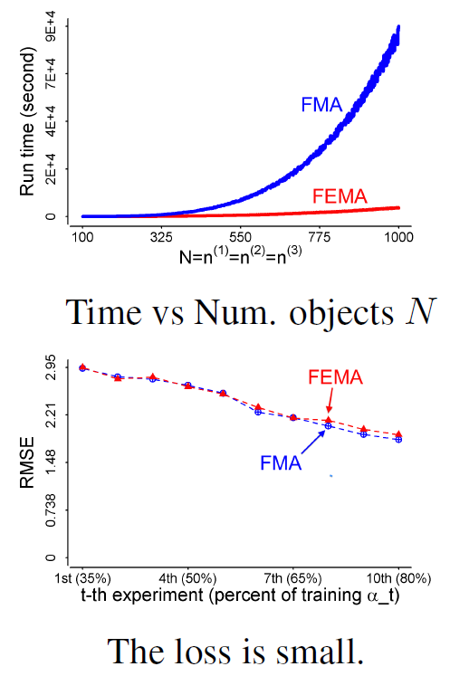
Performance: Efficiency & Small Loss
Re-decomposition:
Re-compute projection matrices
Evolutionary analysis:
Use ΔX to update λ and a
Evolutionary analysis:
Use ΔX to update λ and a
Re-decomposition:
Re-compute projection matrices

Slide 28
Contributions
Analyzed spatial temporal context-based behaviors: multi-faceted/dynamic
Proposed behavioral analysis method FEMA
Improved prediction effects and efficiency on two real datasets
Publication
ACM SIGKDD 2014 (Full. Acc. rate=14.6%.)

Slide 29
ROadmap
Contextual behavior analysis & modeling
Social context-based behavioral model
Spatial and temporal context-based analysis
Cross-domain/platform behavior modeling
Cross-domain hybrid random walk algorithm
Cross-platform semi-supervised transfer learning
Suspicious behavior analysis & detection
Detecting synchronized suspicious users
Evaluating suspicious multi-faceted behaviors

Slide 30
P3 & C: Cross-domain Behavior Modeling
Tencent Weibo data
Multi-domain social media: post, label, video…
C1：Sparsity and cold start in target domain
C2：Heterogeneity in multiple domains
Domain | Size | Cross-domain Link（User-Item）
 |  | Adopt（+） | Refuse（-）
User | 53.4K | — | —
Weibo | 142K | 1.47M (0.02%) | 3.40M (0.04%)
Label | 111 | 330K (5.57%) | —

Slide 31
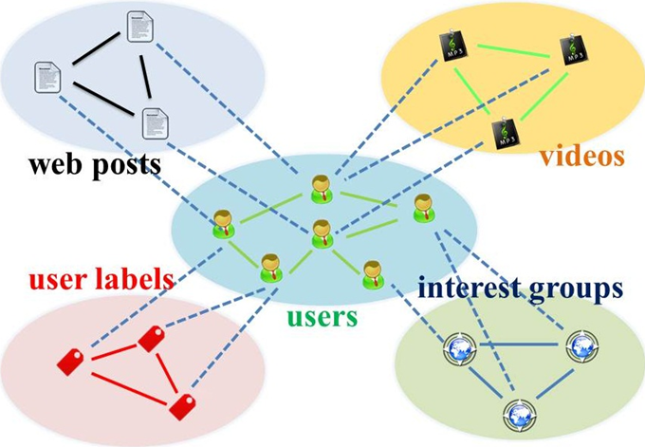
Idea: Social Domain as Bridge
Reframe social media: Star-structured graph with social domain in the center
Transfer learning
Auxiliary domain → Social domain → Target domain

Slide 32
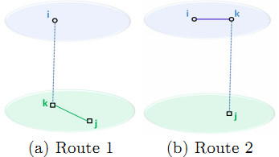
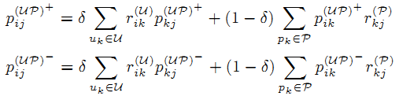
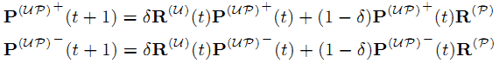
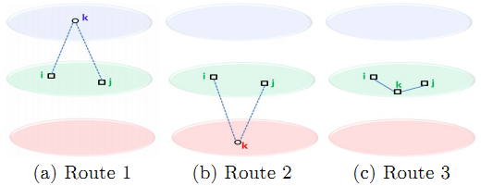
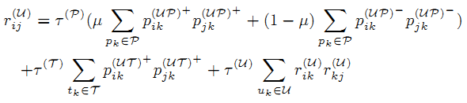
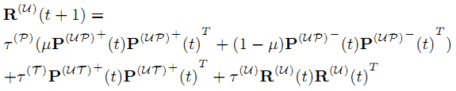
Hybrid Random Walk Algorithm
Update cross-domain link weights
Update within-domain link weights

Slide 33
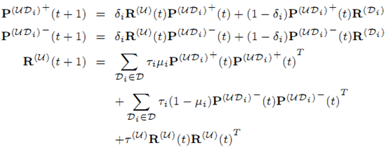
Hybrid Random Walk Algorithm
On high-order star-structured graph

Slide 34
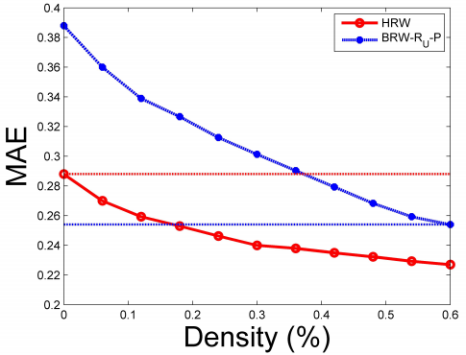
Performance: Predicting Cold-start Behaviors
Knowledge transfer from auxiliary domains improves cold-start users’ behavior prediction
Using aux. (label) data, saving >60% tgt. (post) data
35% user-post
0 user-label
0 user-post
100% user-label
60% user-post
0 user-label
18% user-post
100% user-label

Slide 35
Contributions
Analyzed cross-domain behavior modeling problem: Using social domain as bridge
Proposed a novel Hybrid Random Walk method
Improved behavior prediction in target domain and provided effective solutions to cold start
Publication
ACM CIKM 2012 (Full paper.Acc. rate=13.8%.)
IEEE TKDE 2015 (to appear. Regular.)
Citation count: 32

Slide 36
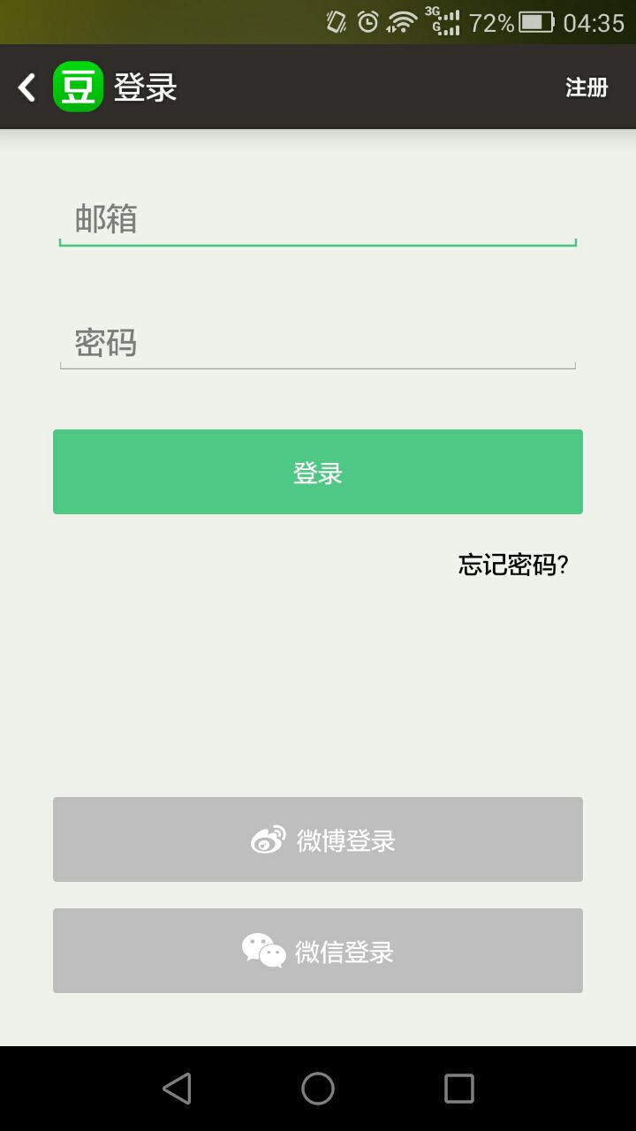
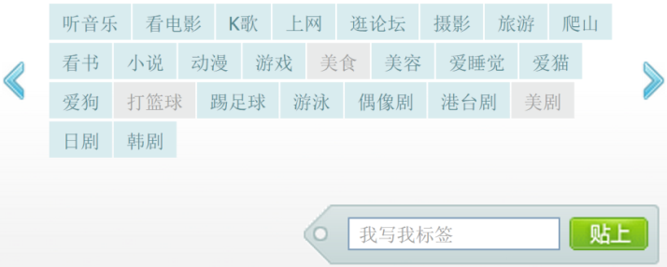

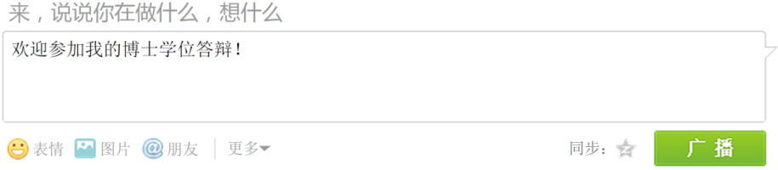



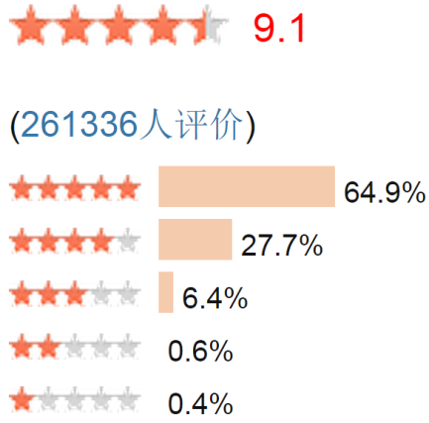
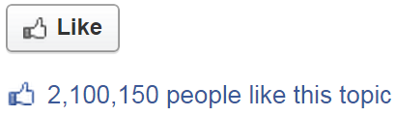


P4: Cross-platform Behavior Modeling
Social label
Tweet & Retweet
Video, Music …
Movie rating
“Like”message, page

Slide 37
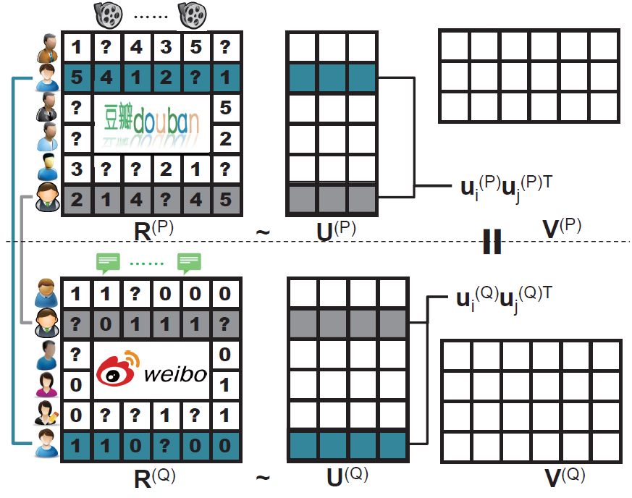
C & Idea
Goal: Solve high sparsity problem in target platform
Solution: Using knowledge from auxiliary platform
Challenges
Heterogeneity
Non-uniform representation
Auxiliary platform

Slide 38
C & Idea
Constraints to user representations:
Similarity between overlapping users
Goal: Solve high sparsity problem in target platform
Solution: Using knowledge from auxiliary platform
Challenges
Heterogeneity
Non-uniform representation
Idea
Partially overlapping users across platforms
Overlaps
Auxiliary platform

Slide 39
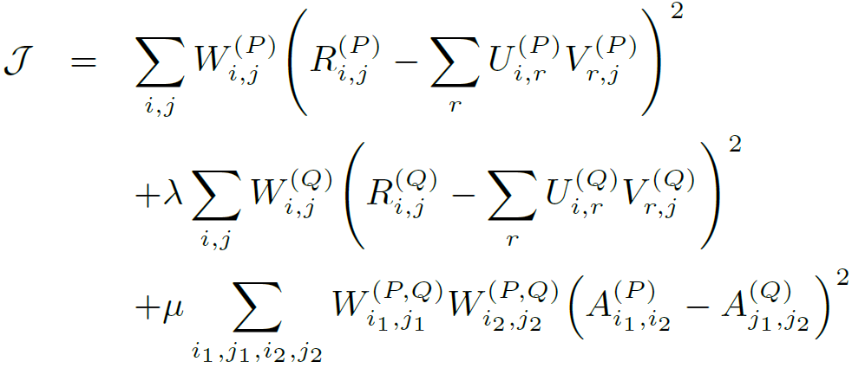
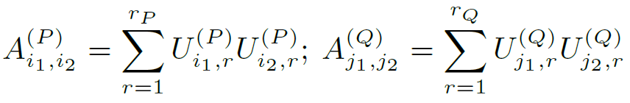
XPTrans: Semi-supervised Transfer
Input
Tgt./Aux. platform P/Q;
Behavior data R^{(P)}/R^{(Q)};
Observation W^{(P)}/W^{(Q)};
Overlapping indicator W^{(P,Q)},
Output
User latent representation U^{(P)}/U^{(Q)};
Item latent representation V^{(P)}/V^{(Q)};
Missing values in R^{(P)}
Objective function
Unsupervised term
Target platform
Auxiliary platform
Overlapping
user similarity
Supervised term

Slide 40
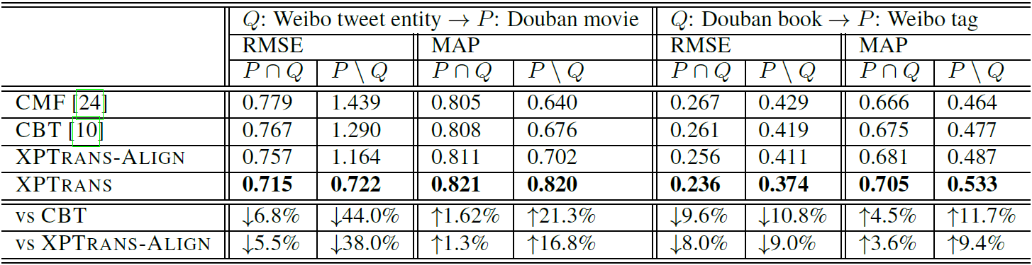
Performance: Behavior Prediction
Baselines
CMF: NOT using knowledge in auxiliary platform
CBT: NOT using overlapping user but sharing “Codebook” pattern
XPTrans-Align: Latent representation of overlaps as constraints
XPTrans: Overlapping users’ latent similarity as constraints
XPTrans improves accuracy by 21%

Slide 41
Contributions
Analyzed cross-platform behavior modeling: Using overlapping users as bridge
Proposed semi-supervised transfer learning method XPTrans
Improved behavior prediction in target platform
Not published yet

Slide 42
ROadmap
Contextual behavior analysis & modeling
Social context-based behavioral model
Spatial and temporal context-based analysis
Cross-domain/platform behavior modeling
Cross-domain hybrid random walk algorithm
Cross-platform semi-supervised transfer learning
Suspicious behavior analysis & detection
Detecting synchronized suspicious users
Evaluating suspicious multi-faceted behaviors

Slide 43





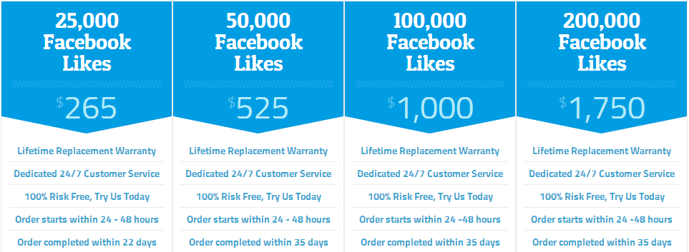



P5: Suspicious Zombie Followers
[www.buyfollowz.org]
[buymorelikes.com]

Slide 44

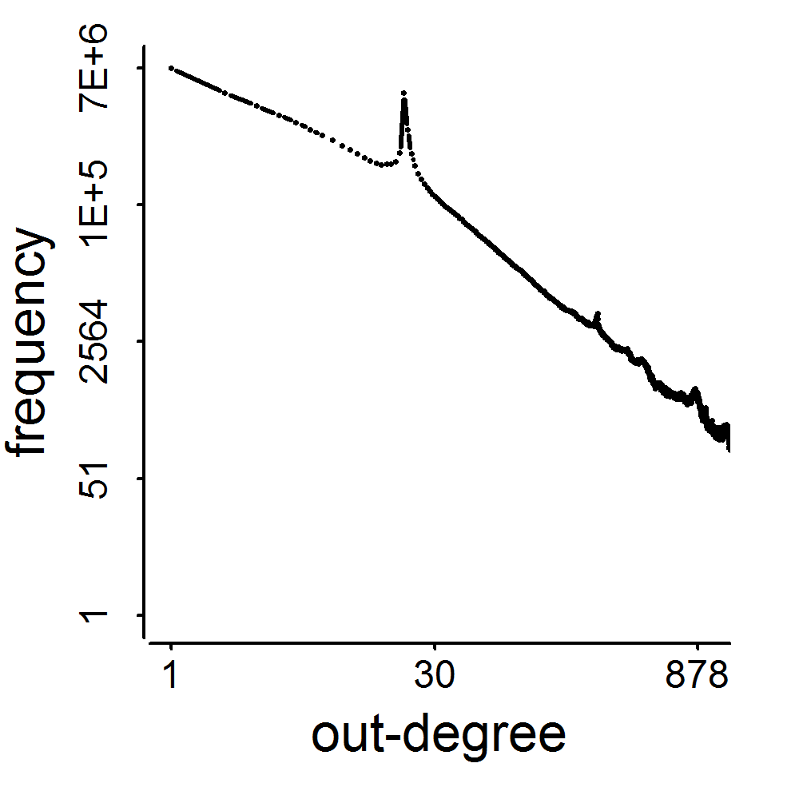
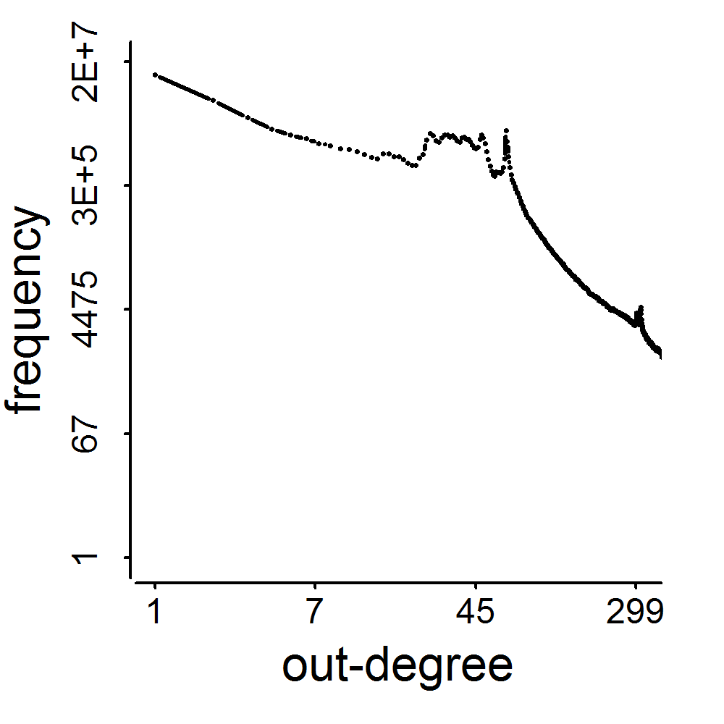
C1: Small Out-degree, Big Spikes
2009
41M
2011
117M
3.17M
1.91M
0.41M
0.44M
d=20
d=64

Slide 45

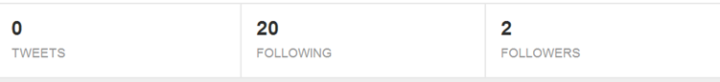
C2: Limitations of Existing Methods
Label (+1,-1) | #followee (out-degree) | #follower (in-degree) | #post | #url in post | #hashtag in post
Content-based
Classifier
Limitation: Poor contents
for unnecessary appearance

Slide 46
Idea: Behavior Pattern is the Key
Monetary Incentive
Content
May show suspicious appearance
Behavior
Have to
behave suspicious

Slide 47

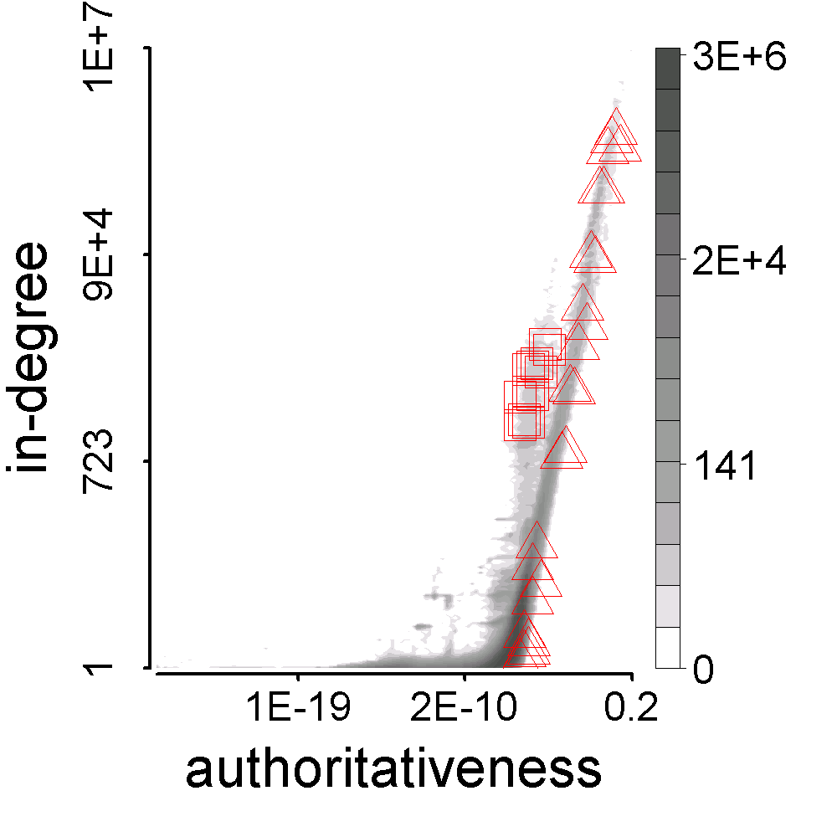
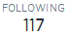


Behavior Pattern: Whom do Zombie Followers Connect to?
Synchronized
Abnormal

Slide 48



Synchronicity & Normality
Synchronicity

Slide 49


Synchronicity & Normality
Normality

Slide 50

Theorem: Given Normality, We have Parabolic Lower Bound of Synchronicity
For any distribution, “Synchronicity-Normality” plot has a parabolic lower limit
Synchronicity
Normality
CatchSync:
Distance-based anomaly detection

Slide 51
Performance: Detecting Labelled Suspicious Accounts
Improving detection accuracy: Complementary between Behavior-based CatchSync and Content-based SPOT
CatchSync+SPOT
CatchSync
SPOT
OutRank
CatchSync+SPOT
CatchSync
SPOT
OutRank

Slide 52


Performance: Recovering Distorted Out-degree Distribution
2009
3.17M
41M
0.41M
d=20

Slide 53
Contributions
Analyzed synchronized and abnormal behavioral patterns of zombie followers
Proposed CatchSync: Detecting synchronized behaviors in large-scale graphs
Recovered out-degree distribution to smooth and power-law-like
Publication
ACM SIGKDD 2014 (Full. Acc. rate=14.6%. Best paper finalist.)
ACM TKDD 2015 (to appear.Special issue.)
Citation count: 18

Slide 54


P6 & C: Measuring Suspicious Behaviors in Multi-modal Data
2 modes, and 3 modes, which is more suspicious?
Dense
block:
200 minutes
120 minutes
time
time
225
user
40
user
IP
12,375
2
27,313
Data：

Slide 55
Idea: Multi-modal Suspiciousness
Measuring multi-modal dense blocks
Dense block+Data：
Probability
0.9%
0.05%
More suspicious
Priority for detecting

Slide 56

Metric: “Suspiciousness”
Suspiciousness = Negative log likelihood of block’s probability under Erdos-Renyi-Poisson
Local search
CrossSpot

Slide 57

Satisfying Axioms

Slide 58

Advantage: “Suspiciousness”+CrossSpot
Scoring dense blocks
Targeting multi-modal data
Satisfying axioms

Slide 59

Performance: Synthetic Data
Experiments: Synthetic data
1,000×1,000×1,000 of 10,000 random data
Block#1: 30×30×30 of 512 3 modes
Block#2: 30×30×1,000 of 512 2 modes
Block#3: 30×1,000×30 of 512 2 modes
Block#4: 1,000×30×30 of 512 2 modes

Slide 60
Three Real Datasets
Dataset | Mode |  |  |  | Mass
Retweeting | User | Root ID | IP | Time (min) | #retweet
 | 29.5M | 19.8M | 27.8M | 56.9K | 211.7M
Trending (Hashtag) | User | Hashtag | IP | Time (min) | #tweet
 | 81.2M | 1.6M | 47.7M | 56.9K | 276.9M
Network attacks (LBNL) | Src-IP | Dest-IP | Port | Time (sec) | #packet
 | 2,345 | 2,355 | 6,055 | 3,610 | 230,836

Slide 61


Manipulating Popular Trends

Slide 62
Contributions
Cross modes with probability: Proposed a novel metric “suspiciousness” for multi-modal behaviors
CrossSpot: Proposed local search algorithm for suspicious behaviors
Publication
IEEE ICDM 2015 (Short.Acc. rate=18.2%.)

Slide 63
Summary
Complex Behaviors in Social Media:
Analysis, Models and Applications
Contextual behavior
Social contexts for information adoption
Spatial temporal contexts for evolutionary analysis
Cross-domain/platform
Hybrid random walk for cross-domain modeling
Semi-supervised transfer for cross-platform modeling
True/False, Honest/Suspicious
Detecting synchronized behaviors
Measuring suspiciousness of multi-modal user behaviors

Slide 64
Summary
Models & Algorithms
1. ContextMF
[CIKM’12][TKDE’14]
2. FEMA
[KDD’14]
3. HybridRW
[CIKM’12][TKDE’15]
4. XPTrans
5. CatchSync
[KDD’14 ^{best finalist}]
[TKDD’15]
6. CrossSpot
[ICDM’15]
Contextual
Suspicious
Cross-domain
Cross-platform

Slide 65
Achievements
10/12 papers as the 1st author
3×IEEE/ACM Trans. (3×Regular)
7×Top Conf. (5×Full, 1×Short, 1×Poster)
Selected papers
“Catching sync…”: SIGKDD’14 best paper finalist
“Social context…”: CIKM’12 & TKDE’14 (Cited by 85)
Total citation count: 290
Awards
National Scholarship
Sohu research scholarship

Slide 66
Journal Papers
Meng Jiang, Peng Cui, Fei Wang, Wenwu Zhu and Shiqiang Yang. “Social Recommendation with Cross-Domain Transferable Knowledge”, in IEEE TKDE 2015. (to appear. Regular. IF=1.815.)
Meng Jiang, Peng Cui, Alex Beutel, Christos Faloutsos and Shiqiang Yang. “Catching Synchronized Behaviors in Large Networks: A Graph Mining Approach”, in ACM TKDD 2015. (to appear. Full. IF=1.147.)
Meng Jiang, Peng Cui, Fei Wang, Wenwu Zhu and Shiqiang Yang. “Scalable Recommendation with Social Contextual Information”, in IEEE TKDE 2014. (Regular. IF=1.815. 10 citations till 08/2015.)
Lu Liu, Feida Zhu, Meng Jiang, Jiawei Han, Lifeng Sun and Shiqiang Yang. “Mining Diversity on Social Media Networks”, in Multimedia Tools and Applications 2012.

Slide 67
Conference Papers (cont.)
Meng Jiang, Peng Cui, Alex Beutel, Christos Faloutsos and Shiqiang Yang. “Detecting Suspicious Following Behavior in Multimillion-Node Social Networks”, in WWW 2014. (Poster. 9 citations till 09/2015.)
Meng Jiang, Peng Cui, Rui Liu, Qiang Yang, Fei Wang, Wenwu Zhu and Shiqiang Yang. “Social Contextual Recommendation”, in CIKM 2012. (Full. Acc. rate=13.4%. 74 citations till 09/2015.)
Meng Jiang, Peng Cui, Fei Wang, Qiang Yang, Wenwu Zhu and Shiqiang Yang. “Social Recommendation across Multiple Relational Domains”, in CIKM 2012. (Full. Acc. rate=13.4%. 32 citations till 08/2015.)
Lu Liu, Jie Tang, Jiawei Han, Meng Jiang and Shiqiang Yang. “Mining Topic-Level Influence in Heterogeneous Networks”, in CIKM 2010.

Slide 68
Conference Papers
Meng Jiang, Alex Beutel, Peng Cui, Bryan Hooi, Shiqiang Yang and Christos Faloutsos. “A General Suspiciousness Metric for Dense Blocks in Multimodal Data”, in IEEE ICDM 2015. (Short. Acc. Rate=18.2%.)
Meng Jiang, Peng Cui, Alex Beutel, Christos Faloutsos and Shiqiang Yang. “CatchSync: Catching Synchronized Behavior in Large Directed Graph”, in ACM SIGKDD 2014. (Full. Best paper finalist. Acc. rate=14.6%. 9 citations till 09/2015.)
Meng Jiang, Peng Cui, Fei Wang, Xinran Xu, Wenwu Zhu and Shiqiang Yang. “FEMA: Flexible Evolutionary Multi-faceted Analysis for Dynamic Behavioral Pattern Discovery”, in ACM SIGKDD 2014. (Full. Acc. rate=14.6%.)
Meng Jiang, Peng Cui, Alex Beutel, Christos Faloutsos and Shiqiang Yang. “Inferring Strange Behavior from Connectivity Pattern in Social Networks”, in PAKDD 2014. (Full. Acc. rate=10.8%. 10 citations till 08/2015.)

Slide 69
Submitted Papers
Meng Jiang, Peng Cui, and Christos Faloutsos. “Suspicious Behavior Detection: Current Trends and Future Directions”, to IEEE Intelligent Systems Magazine Special Issue on Online Behavioral Analysis and Modeling (IS, submitted).
Meng Jiang, Peng Cui, Nicholas Jing Yuan, Xing Xie, and Shiqiang Yang. “Little is Much: Bridging Cross-Platform Behaviors Through Small Overlapped Crowds”, to AAAI Conference on Artificial Intelligence (AAAI, submitted).
Meng Jiang, Peng Cui, Alex Beutel, Christos Faloutsos and Shiqiang Yang. “Inferring Lockstep Behavior from Connectivity Pattern in Large Graphs”, to Knowledge and Information Systems (KAIS, accepted with minor revision).

Slide 70









Discussion: 1+1 > 2?
Knowledge
Data
Data
Network
Network
Brain
Behavioral data
User-based
Informal, noisy, huge, structured
Publication data
Text-based
Formal, clean, high-quality, unstructured

Slide 71

Discussion: Cross-Network! Behavior + Information
Behavioral networks:
Social relational links
Content-based links
Behavioral links (scattered)
Noisy but Daily increasing
Challenges:
Both huge + sparse + heterogeneous
When structured meets unstructured
When clean meets noisy
Applications:
Behavior prediction
Suspicious behavior detection
Information network enrichment
Information networks:
Document (paper, news) – Concept links
Concept relational links
Unstructured but Valuable

Slide 72
Thank you!

